Slide 1
Beat the AI ! Rock Paper Scissors

Slide 2



How it WORKS
?
?

Slide 3
HoW IT Works
?

Slide 4
HoW IT Works
?

Slide 5
HOW IT WORKS
?

Slide 6
HOW IT WORKS
?

Slide 7
HOW IT WORKS
?
2
1

Slide 8
HOW IT WORKS
?
0
2
2
2
0
1
3
1
3

Slide 9
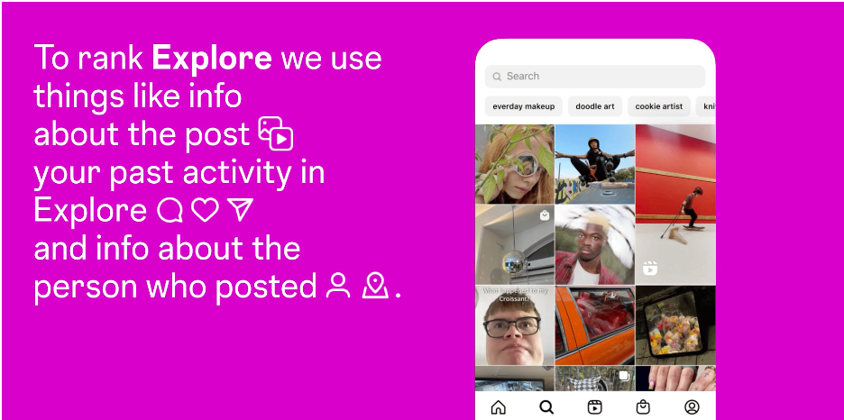
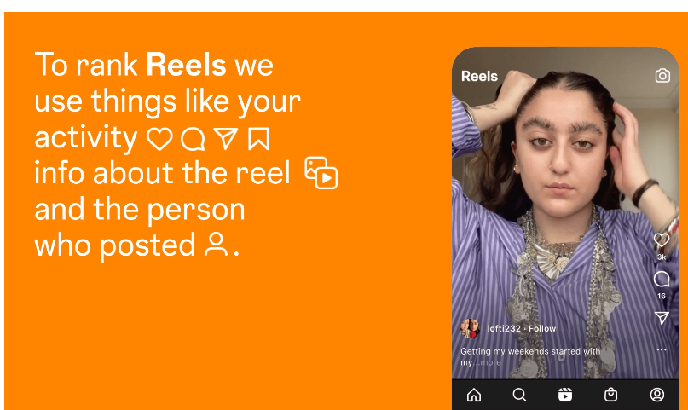


How DOES INSTAGRAM/TIKTOK suggest the next VIDEO?
https://about.instagram.com/blog/announcements/instagram-ranking-explained

Slide 10
How DOES CHATGPT Work?
May the force be with ? you
We hold these truths to be self-evident, that all ? men are created equal…

Slide 11
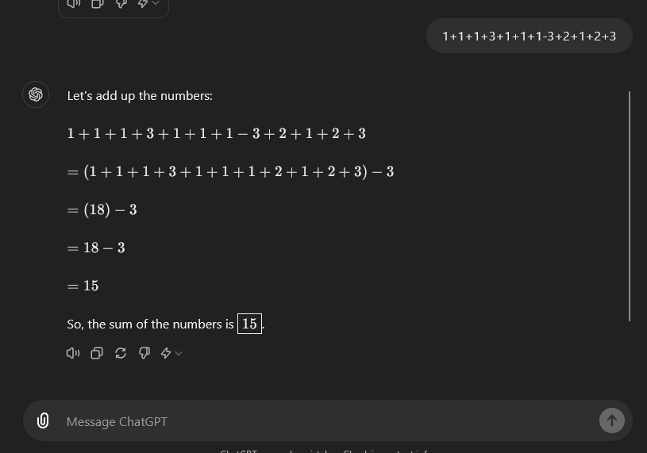
CHATGPT and the MCAS?

Slide 12
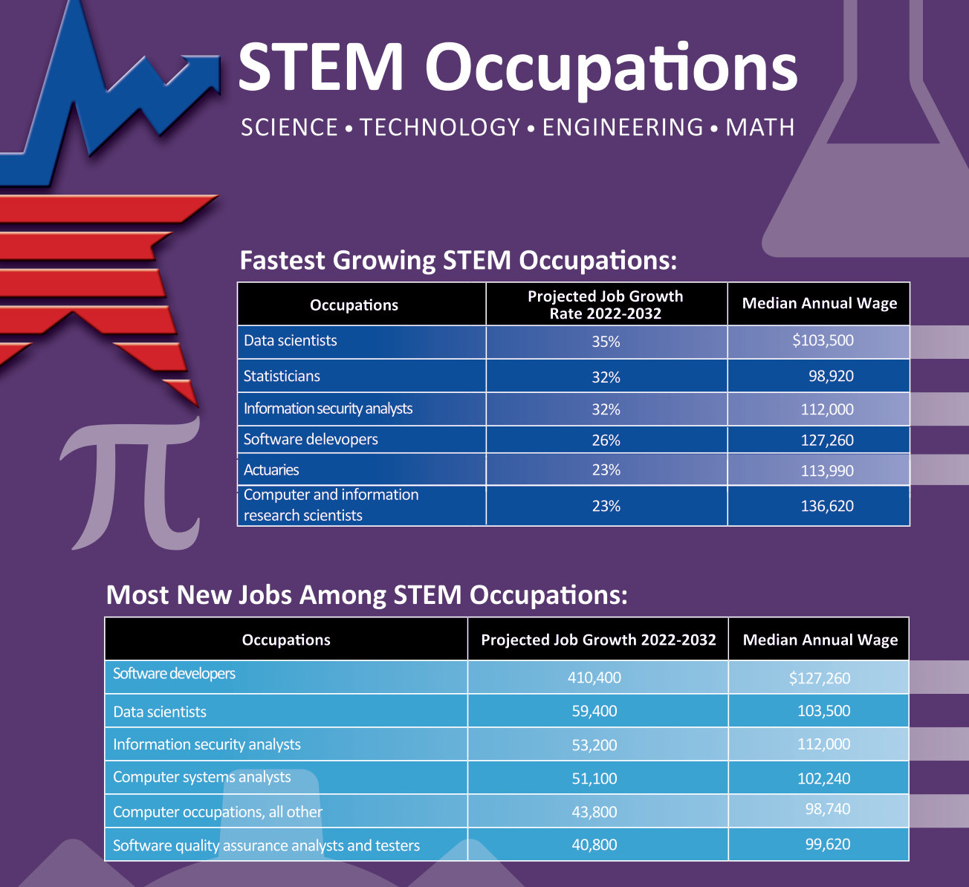

Notes:
https://erajasekar.medium.com/what-middle-school-students-need-to-know-about-computer-science-and-software-engineering-job-14e12404fe73

